Slide 1
Resume Screening for Recruitment
Presented by,
MADHUMMITHA V - 313522104087
MAHADURGA P - 313522104088
MAITREYI T - 313522104089

Slide 2
Problem Statement and Impact
Problem Statement: Recruiters manually review hundreds of resumes daily, which is time-consuming, error-prone, and inefficient.
Impact:
Automates resume shortlisting.
Ensures unbiased, data-driven hiring decisions.
Reduces recruitment time and cost.

Slide 3
Abstract and Pros
Abstract: We developed a machine learning model that classifies resumes as "Hire" or "Reject" using textual features (skills) and numerical features (experience, certifications, etc.).
Pros:
Faster candidate filtering
Objective and scalable
Supports multiple formats (.txt, .pdf)

Slide 4
Algorithm and Tools
Algorithm:
Random Forest Classifier (chosen for its robustness and interpretability)
Tools & Libraries:
Python
Scikit-learn
Pandas, NumPy
TF-IDF for skill extraction
PyMuPDF (for PDF parsing)

Slide 5
Metrics
Model Evaluation Metrics:
Accuracy : 82.88%
Precision : 0.83
Recall : 1
F1-Score : 0.91

Slide 6
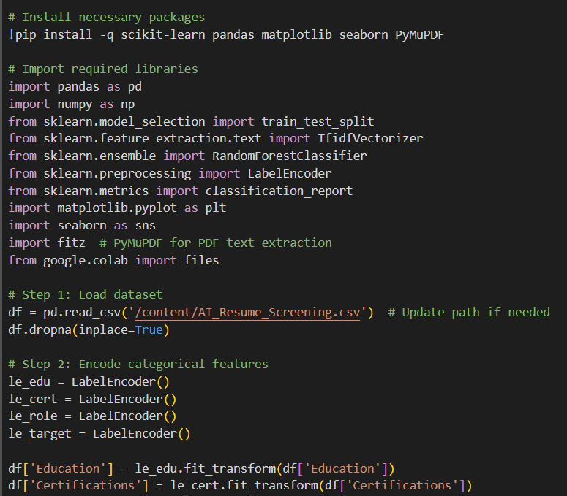
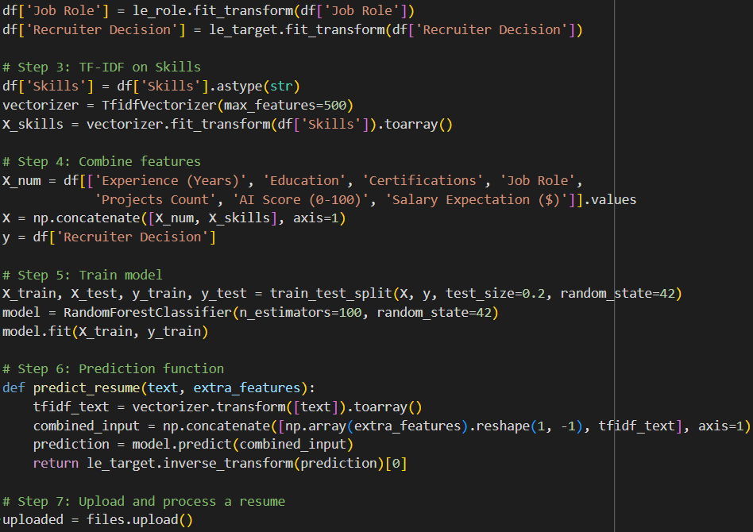
Coding

Slide 7
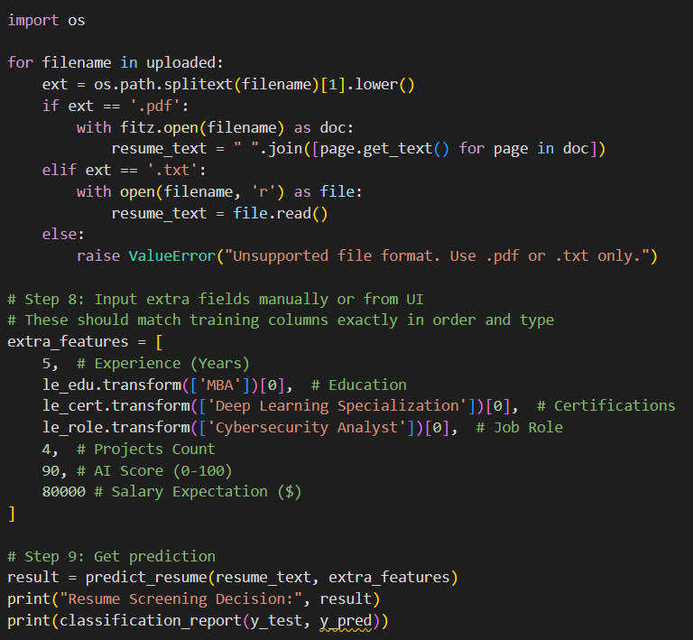
Coding

Slide 8
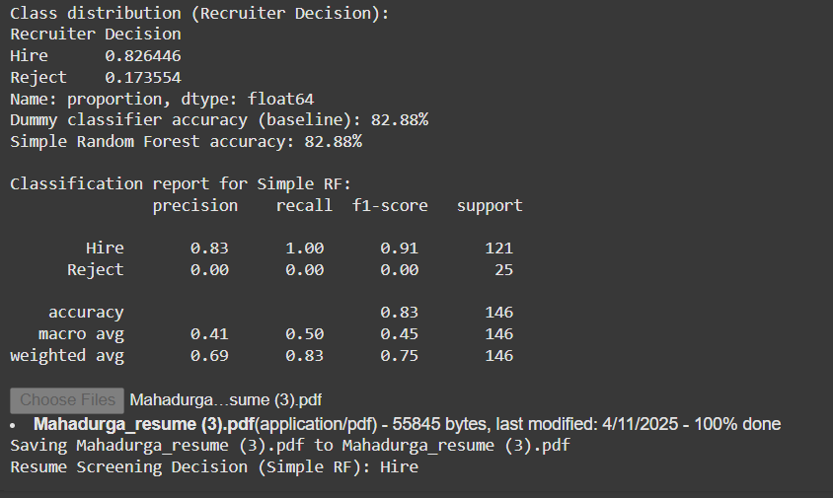
Output Screenshot

Slide 9
Thanking You !

